Slide 1

Predicting Used Car Prices
ENTITY Data Science Program – Final Project
Amrita Guha
September 2022
Notes:
Supervised Machine Learning Endeavor

Slide 2
Overview
Task Breakdown
Data Exploration
Data Wrangling
Multiple Linear Regression Model
Machine Learning Method
Limitations
Assumptions for Multiple Linear Regression
Inferences
Conclusion

Slide 3




Task Breakdown
Objective: predict the price of a used car depending on its specifications using multiple linear regression
Determining which variables influence used car prices
Requires data exploration
Create a multiple linear regression model
Helps determine significance of chosen variables
Requires data wrangling
Create a machine learning algorithm to predict prices
Supervised machine learning
Test accuracy of the model
Notes:
Supervised machine learning - Every observation has a label
Each car is associated with a price

Slide 4

Data Exploration
Variables in the Entire Data Set
Price
Year
Brand
Body
Mileage
EngineV (Engine Volume)
Engine Type
Registration
Model
Dependent variable?
Price
Independent variables?
Data exploration will clarify

Slide 5

Data Exploration Disclaimer
Graphs created in Tableau involve aggregate sums of the price
So, the price label indicates sales volume
Sales volume depends on price
Value of the car influences price
Indirectly then, value of the car influences sales volume
What affects the value of the car?
These will be predictors for price
Graphs made in Python involve the actual price of the car

Slide 6
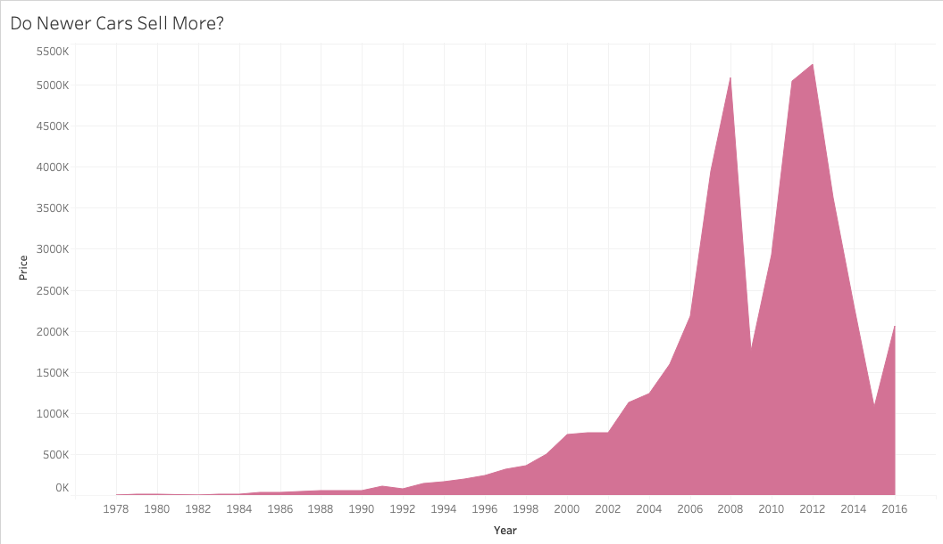
Year
Significant dip in car sales around 2008
Financial crisis
Major spike around 2010
Increase in GDP growth rate
Stark change from 2008
Major dip in 2012
Presidential election
Hurricane Sandy
Unnatural events seem to have influenced dips
There was a steady increase in sales volume prior to select years
So, year is a likely predictor

Slide 7
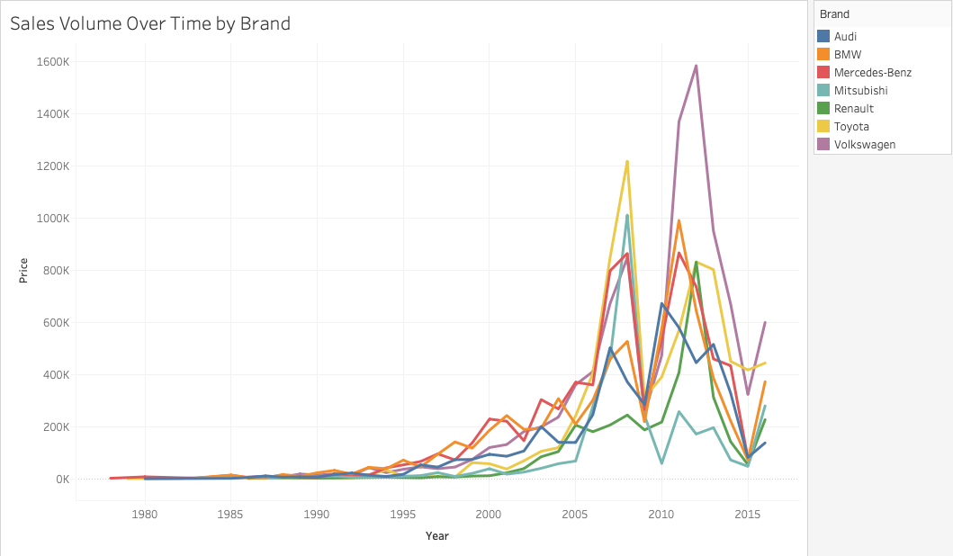
Brand
Some brands clearly sell more cars than others
BMW & Mercedes-Benz were selling the most cars until 2005
Then spike in Toyota & Mitsubishi
After 2012, major spike in Volkswagen
Renault & Audi consistently sold a lower number of cars
Different brands have different sales volumes
Brand affects value of the car
So brand is likely a predictor for price

Slide 8
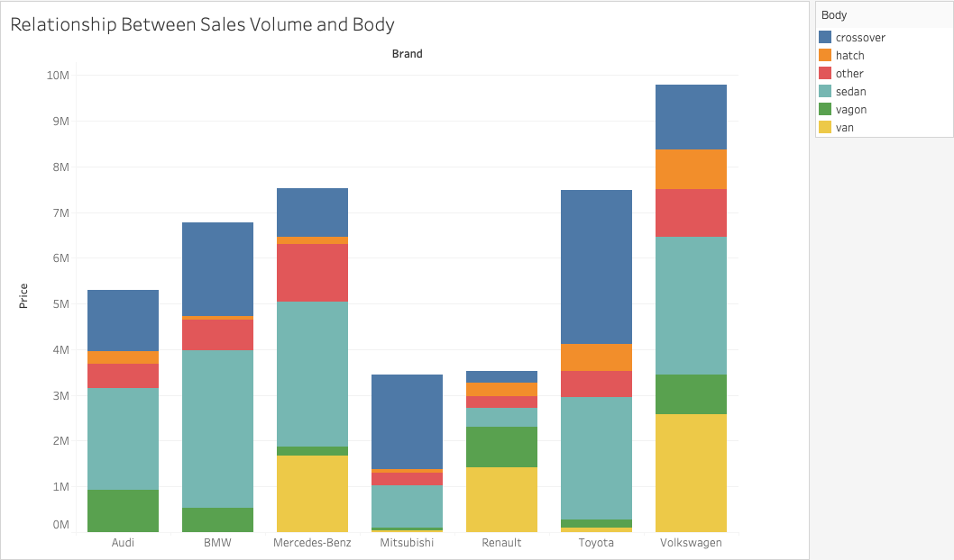
Body
Significant relationship between body and sales volume
Brands that sell a greater number of sedans have higher sales volumes
Volkswagen, Toyota, Mercedes-Benz, BMW, Audi
Brands that sell lower number of sedans have lower sales volumes
Renault and Mitsubishi
Brands selling a lot of vans or crossovers but not too many sedans = lower sales volume
Renault vs. Volkswagen & Mercedes-Benz

Slide 9
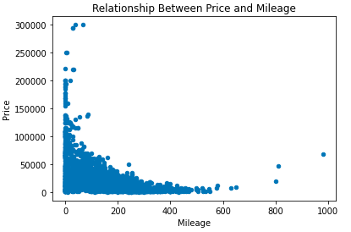
Mileage
Looks like cars with more mileage cost less
Negative exponential relationship
Incremental increases in mileage lead to greater decreases in price

Slide 10
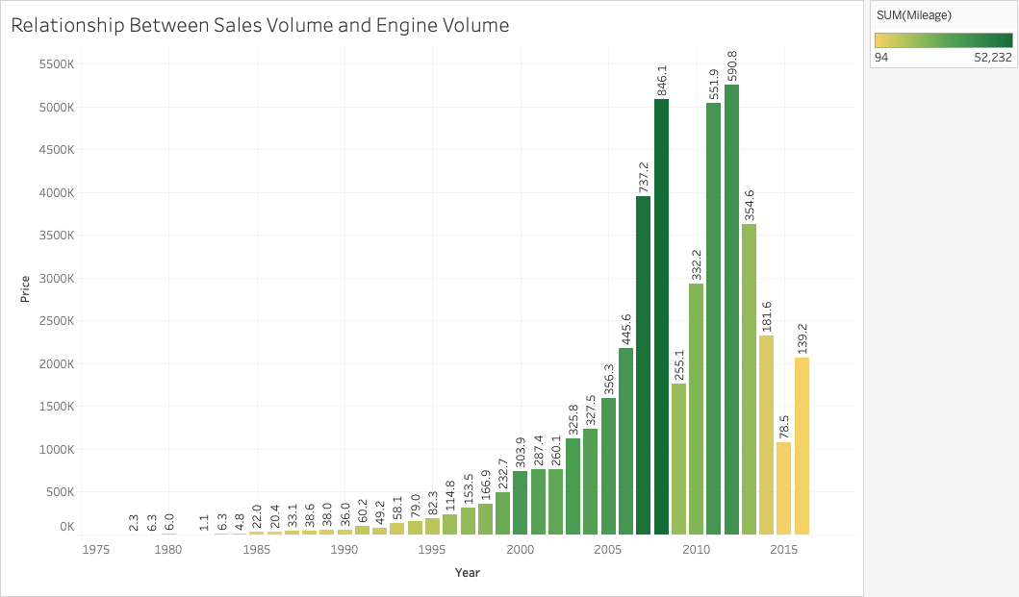
EngineV
Cars with the highest engine volumes tend to sell more
Newer cars don’t necessarily have greater engine volumes
Interesting link between engine volume and mileage
2007, 2008, 2011, 2012
Greater power means traveling greater distances?

Slide 11
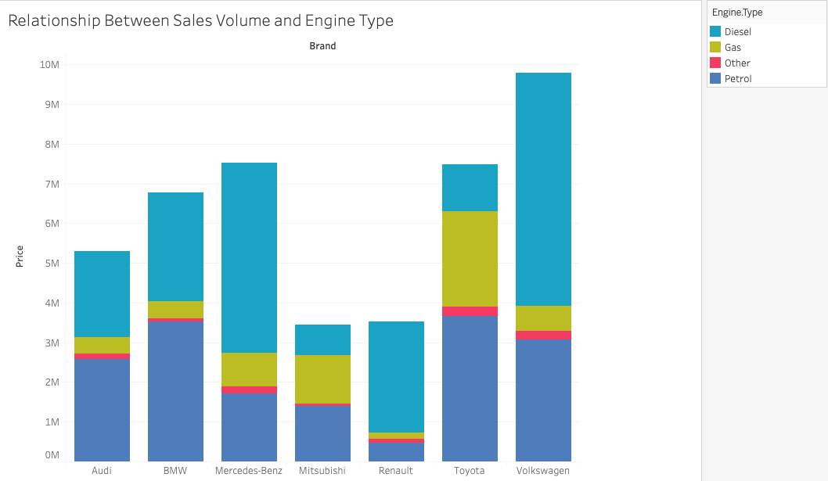
Engine Type
Engine type does not look like a strong predictor of price
Brands with similar engine type breakdowns have different sales volumes

Slide 12
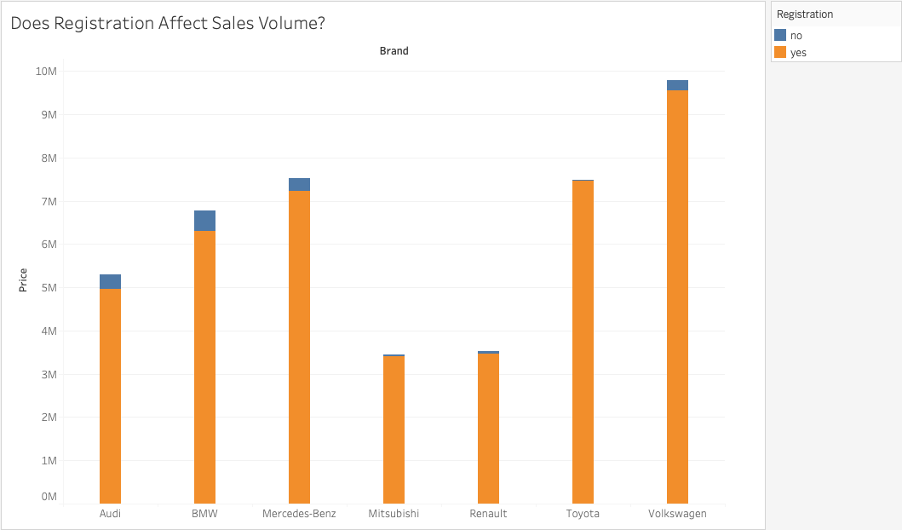
Registration
Registration does not seem to be an indicator
Most cars are registered across all brands
May seem like more expensive cars have more unregistered cars
But unlikely that registration plays a role in price of the car

Slide 13
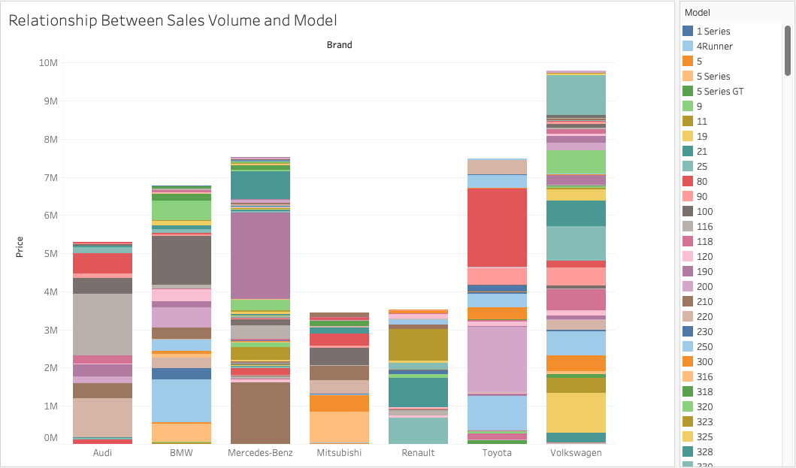
Model
There are 247 different models
Recoding is a possibility but tedious
Some brands have more cars of one model than another
Different brands seem to have different models
Varying colors in the bars
Brand would be a much better indicator

Slide 14
Conclusions from Data Exploration
1 dependent variable:
Price
5 independent variables:
Year: positive relationship
Brand: some brands are more expensive than others
Engine Volume (EngineV): positive relationship
Mileage: negative relationship
Body: some bodies are more popular than others

Slide 15
Data Wrangling (in R)
Omitting missing values
01
Recoding categorical predictors
02
Removing outliers
03
Dropping unnecessary columns
04
Notes:
Wrangling for Multiple Linear Regression

Slide 16
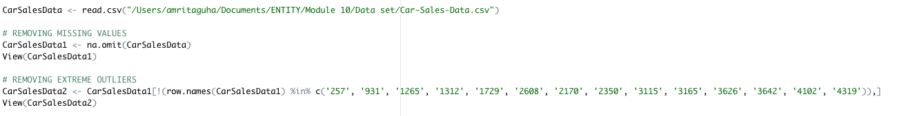
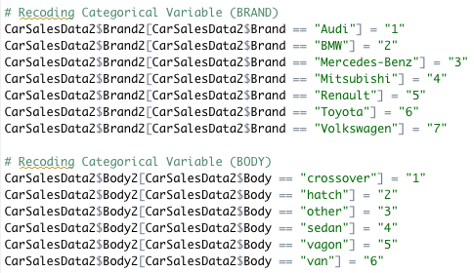
Omitting Missing Values & Extreme Outliers and Recoding Categorical Variables

Slide 17
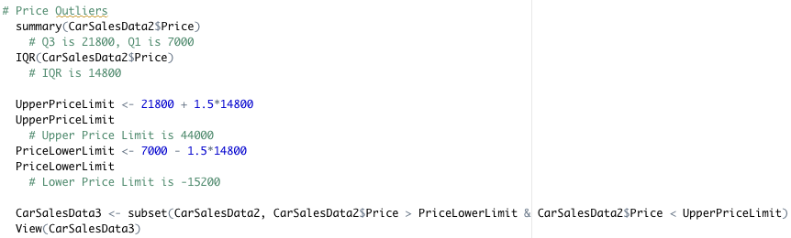
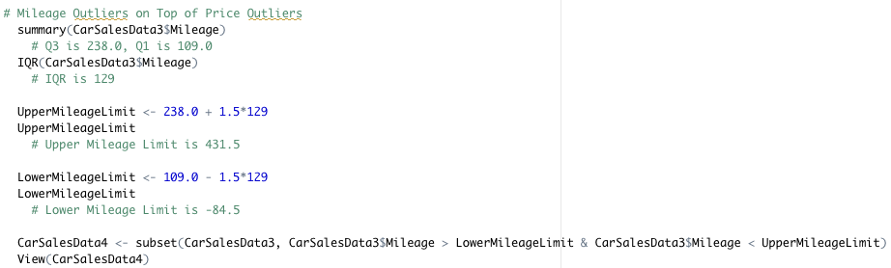
Removing All Outliers

Slide 18
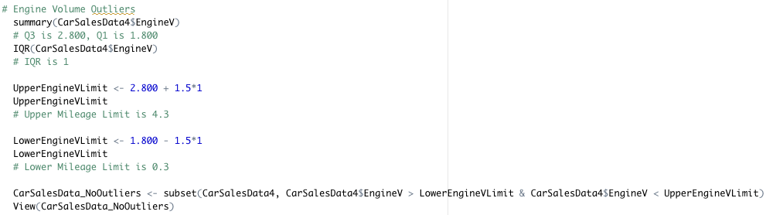
Removing All Outliers (cont.)

Slide 19
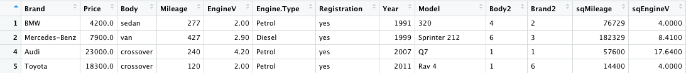
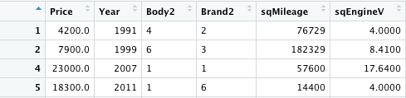
Dropping Unnecessary Columns

Slide 20
Assumptions for Multiple Linear Regression
Linearity between dependent & independent variables
Homoscedasticity
(the error term is normally distributed)
Homogeneity of variance
(the variance of the error terms is constant for all values of x)
Fixed independent variables & measured without error
(the x's can be considered as known constants.)
No multicollinearity
(the observations are independent)
Lack of outliers

Slide 21
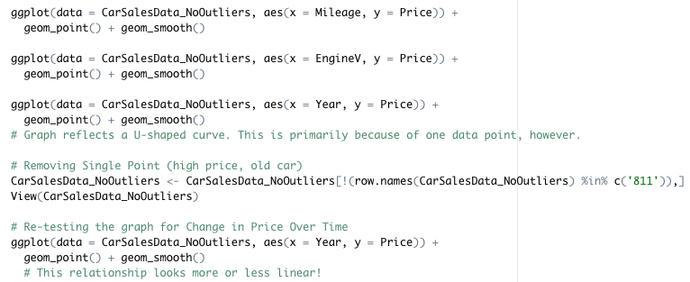
ASSUMPTION #1: Linearity Between Dependent & Independent Variables
All required some sort of transformation
Mileage:
Upside down “U-Shaped” curve for more expensive cars with less mileage
Negative relationship
EngineV:
Very wavy line
Positive relationship
Year:
”U-Shaped” curve from only one point
Positive relationship

Slide 22
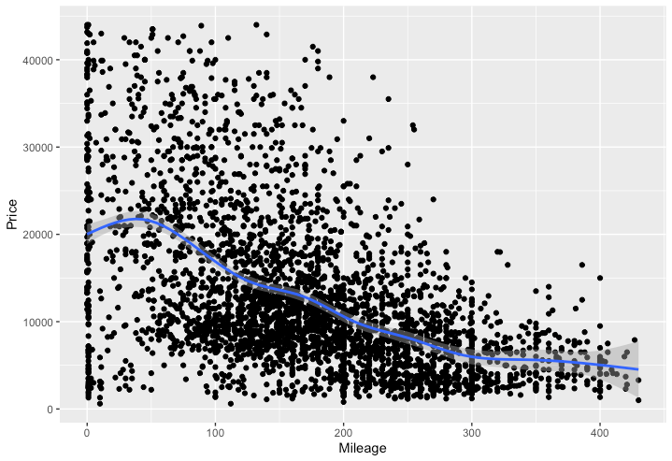
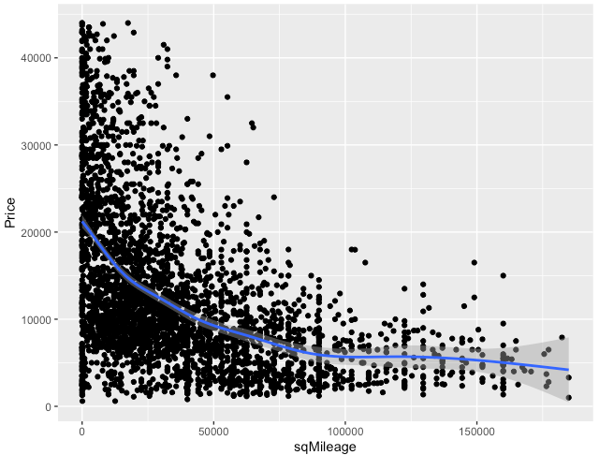
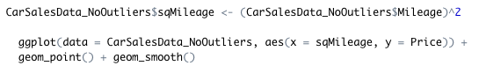
Fixing Linearity Between Price and Mileage
CODE USED:

Slide 23
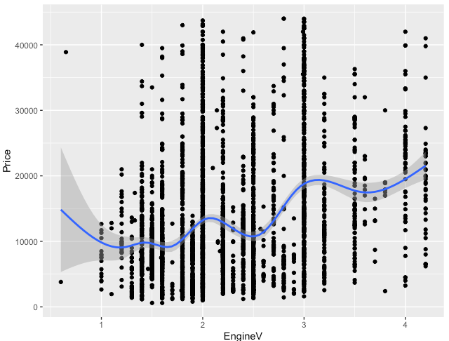
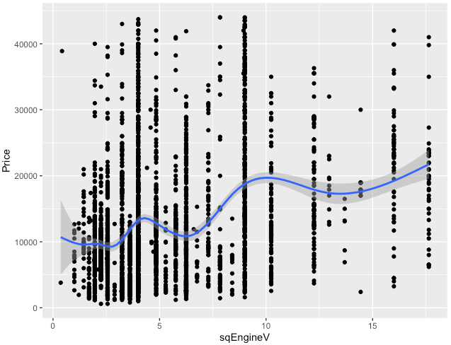
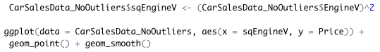
Fixing Linearity Between Price and Engine Volume
CODE USED:

Slide 24
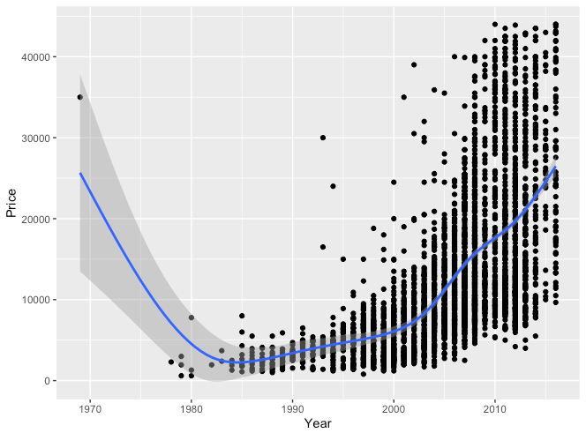
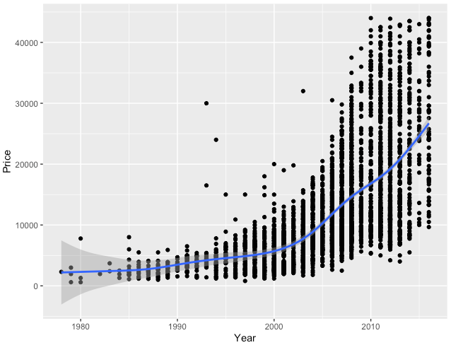
Fixing Linearity Between Price and Year
CODE USED:

Slide 25
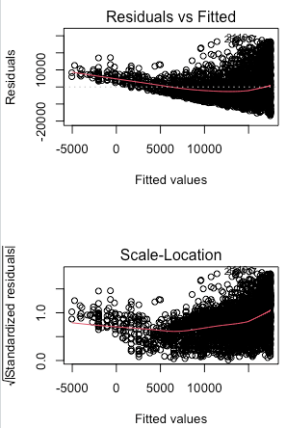
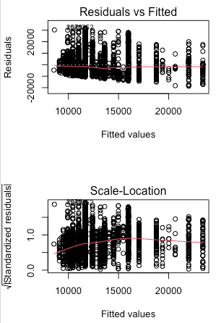
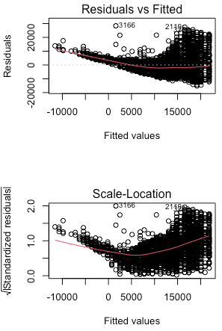
ASSUMPTION #2: Homoscedasticity
Relevant graphs: residuals vs. fitted & scale-location
Graphs for Mileage and Year clearly indicated heteroscedasticity
Cone shaped residuals
Graph for Engine Volume was inconclusive
But the results of the Breusch-Pagan test for each variable indicated heteroscedasticity
MILEAGE
ENGINEV
YEAR

Slide 26
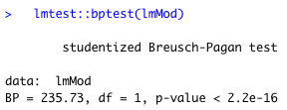
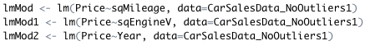
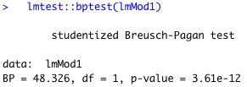
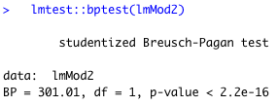
Breusch-Pagan Test Results
Significant results indicate heteroscedasticity

Slide 27
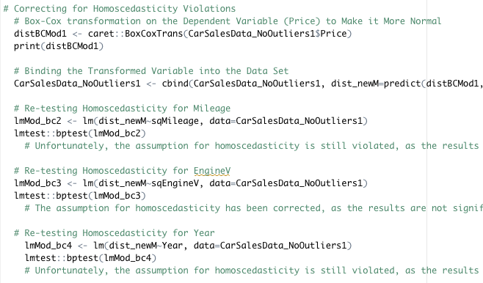
Correcting for Homoscedasticity Violations
Box-Cox transformation to make the dependent variable more normal
Then, bound the transformed variable into the data set
Finally, re-tested homoscedasticity for each continuous variable

Slide 28
ASSUMPTION #3: Homogeneity of Variance
Graphs for Mileage and Year clearly indicated violations
Cone shaped residuals
But the graphs for Engine Volume “fit in a box”
Indicates there is homogeneity of variance,
EngineV variable satisfies assumption
Fixing would require transforming the variables again
Undesirable because would put linearity assumption in jeopardy again
Prioritizing which assumptions are more important
MILEAGE
ENGINEV
YEAR
Notes:
Looking at same graphs from assumption 2

Slide 29

ASSUMPTION #4: Fixed Independent Variables & Measured Without Error
Testing the independent variables as known constants
Nearly impossible to check
Usually just assumed
But there is always some degree of error in data collection
Possible limitation

Slide 30
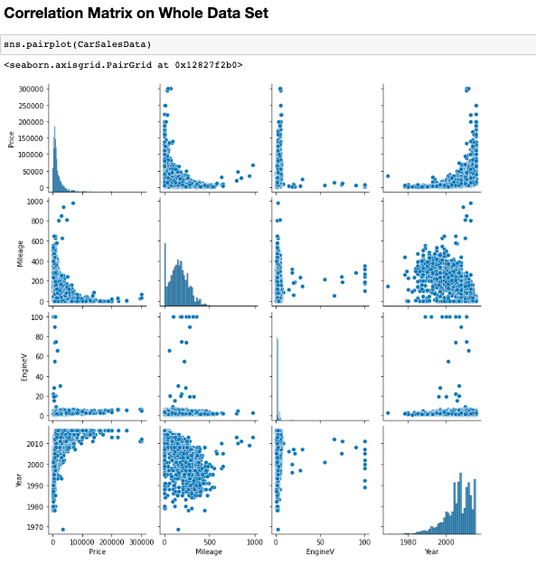
ASSUMPTION #5: No Multicollinearity
Likely that this assumption has been violated
Correlation between mileage and year
Negative linear relationship
But looks like there are a few outliers
No other strong correlations to be aware of
May lead to overfitting
But correlation is not causation
Perhaps newer cars just have not been used as much

Slide 31
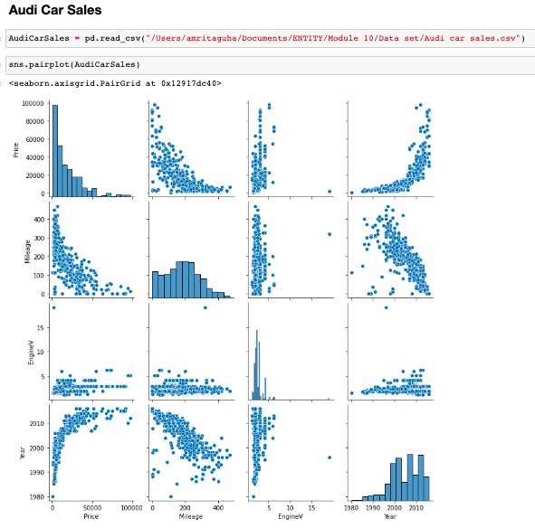
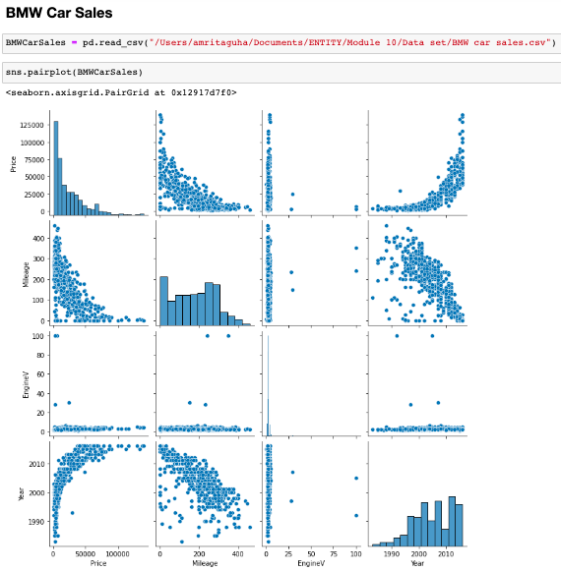
Correlation Between Mileage and Year for Each Brand

Slide 32
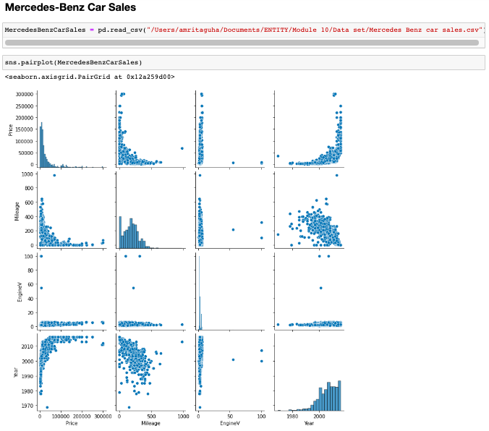
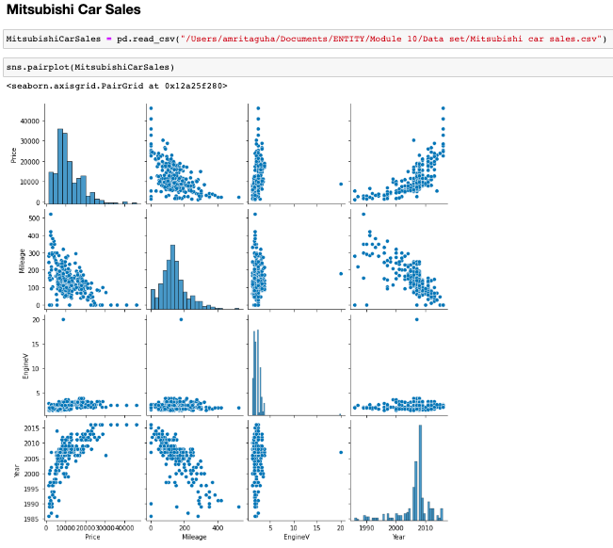
Correlation Between Mileage and Year for Each Brand (cont.)

Slide 33
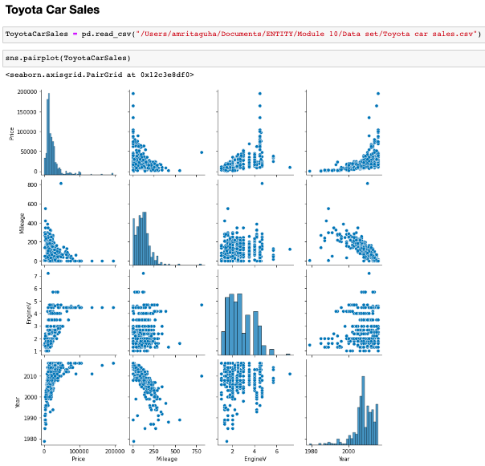
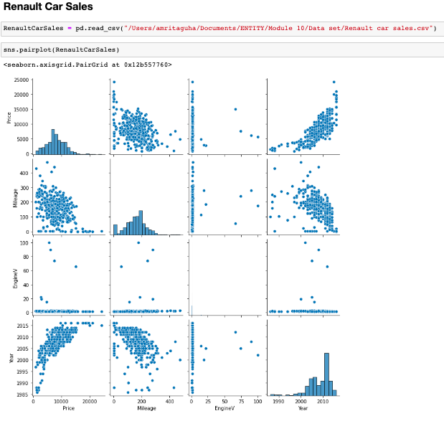
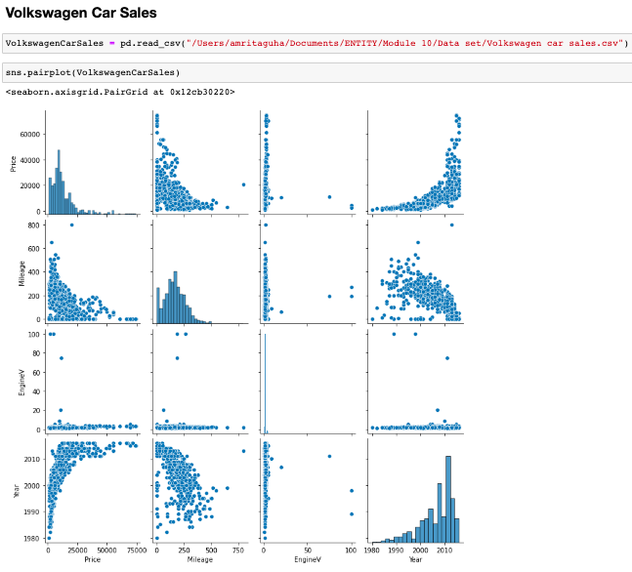
Correlation Between Mileage and Year for Each Brand (cont.)

Slide 34
ASSUMPTION #6: No Outliers
This was already dealt with in data wrangling!

Slide 35
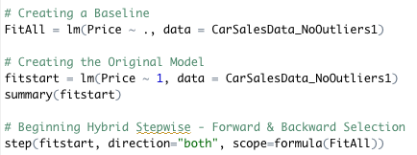
Multiple Linear Regression Model Stepwise Regression (Hybrid Selection)
Notes:
Stepwise Regression (Hybrid Selection)
Baseline contains all relevant variables
From new data set
No unnecessary columns, missing values or outliers
Original model includes only price

Slide 36
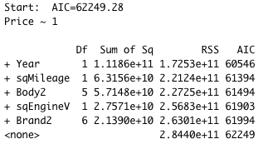
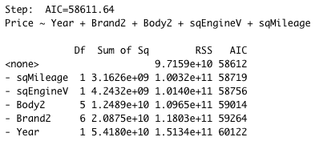
Stepwise Regression Results
Trying to get Akaike Information Criteria (AIC) to be smaller
Adding each predictor individually decreases the AIC
Year has the greatest impact, brand has the smallest
In the end, the AIC is smaller and removing any one of them from the model increases the AIC

Slide 37
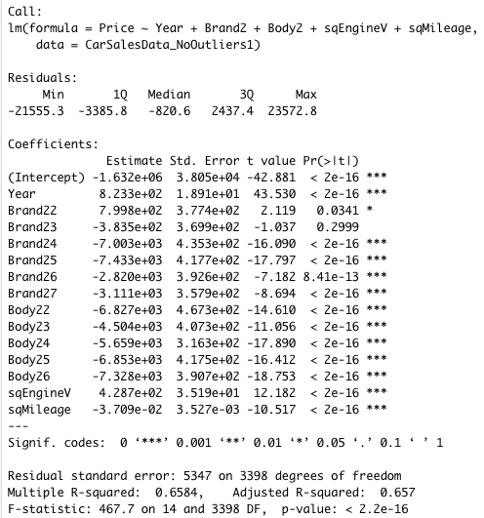
Analysis of Final Multiple Linear Regression Model
The adjusted R^2 is 0.657
Indicates that the model explains 65.7% of the variation in Price
The p-value is far less than 0.05
Means the model is statistically significant

Slide 38
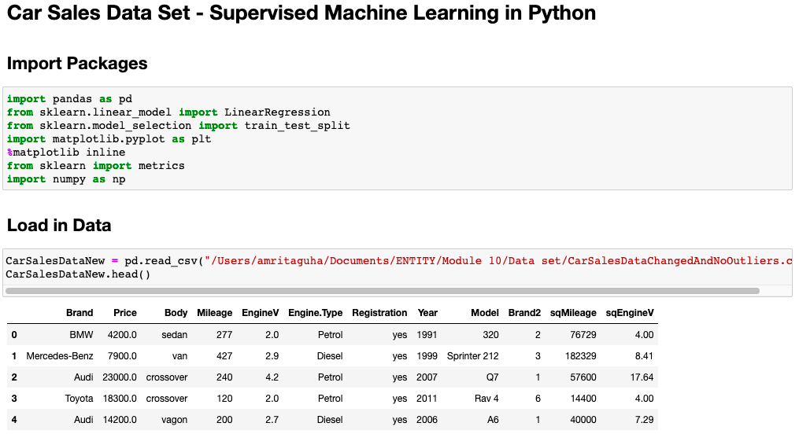
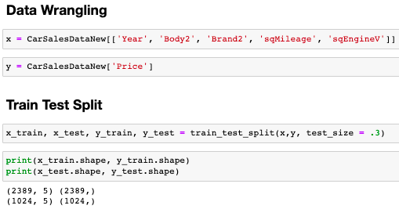
Machine Learning Method (in Python)
Notes:
Created vectors for independent & dependent variables
Train test split was 70/30; 30% was for testing, 70% was trained

Slide 39
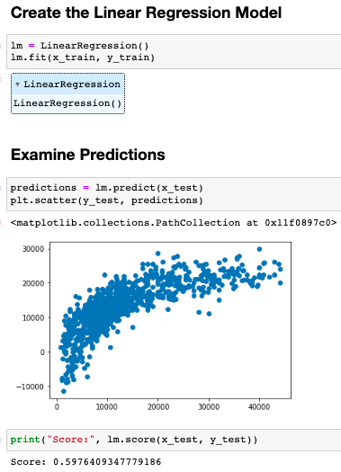
Machine Learning Method (cont.)
The straighter the line, the better the model fit
Graph indicates a curve rather than a straight line
Accuracy score indicates model is accurate 59.8% of the time
Notes:
Created vectors for independent & dependent variables
Train test split was 70/30; 30% was for testing, 70% was trained

Slide 40
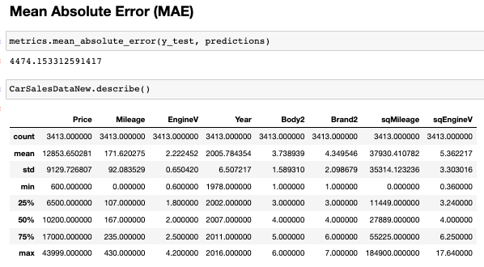
Examining Error in the Machine Learning Model
The average amount of error between the prediction and the real data is over $4,474
The max price in the data set is $43,999 and the average price is $12,853
A difference of over $4,474 can be concerning

Slide 41
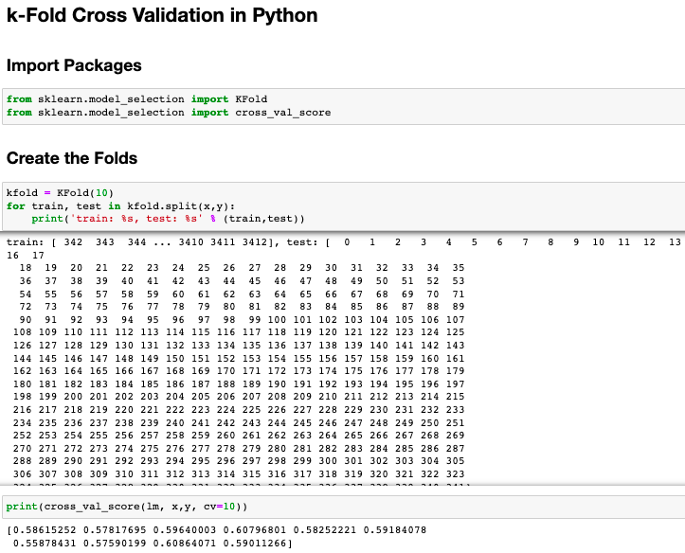
Examining Accuracy of the Machine Learning Model
K-Fold Cross Validation to determine accuracy
Created 10 folds due to large size of data set
Expected for the scores to vary
But all 10 of the trained models were accurate between 56% and 61%.
Majority of scores were around 58%.
The small variance in the cross-validation scores indicate the model is rigorous

Slide 42
Inferences
The data indicates that price of a used car is influenced by year, mileage, body, engine volume and brand in that order
Demonstrated through stepwise regression, hybrid selection
The supervised machine learning model was able to predict 60% of the used car prices
Rigorous machine model due to low variability in k-folds cross validation
10 folds mean 10 tests

Slide 43
Limitations
LIMITATIONS OF THE MODEL
Violation of assumptions – leads to possible bias
No definite linear relationships between dependent and independent variables
Especially Engine Volume; More exponential relationships than linear
Unable to fix for homoscedasticity violations for Mileage and Year
Homogeneity of variance violations for Mileage and Year
Fixing would put linearity assumption in jeopardy
Prioritized linearity because of nature of analysis (multiple linear regression)
Multiple linear regression may not be best fit for this data set
Model explained ~66% of the variation

Slide 44
Limitations (cont.)
LIMITATIONS OF THE DATA SET
Extrapolation of the model is limited to the brands in the data
Overfitting issue
No Honda, Hyundai, and other popular car brands in the data set
Mitsubishi and Renault cars are not so popular at all
External variables influence the significance of the predictors
For example, maintenance and durability of the car are tied to brands
External variables influence reselling value of the car

Slide 45
Conclusions
Using data visualization techniques in Tableau and Python helped determine which variables were relevant
The multiple linear regression model indicated the significance of the predictors on the dependent variable
Explained variability in the model
The strength of the machine learning model is subject to the limitations of the data
Bias from the models due to violation of assumptions
Data not taken into consideration
Also, outside factors can heavily impact the price of the used car
Ie) rise of international oil prices due to war, emergence of sustainable alternatives to power vehicles, events that affect purchasing power, alternate modes of transportation, parking concerns.
Notes:
alternatives to power vehicles – green energy & electric cars
events that affect purchasing power – COVID, financial crises
alternate modes of transportation – zipcar, uber/lyft/ride sharing apps, bus/train

Slide 46
QUESTIONS?

